Slide 1

IMAGE STEGANOGRAPHY
By :
Vishal.B
G.S. Ruparani

Slide 2

PROBLEM STATEMENT
Image Steganography is the process of hiding a secret message which is text-based data within non-text file image file, It is done in such a way someone cannot know the presence of a hidden message in a particular file. Steganography’s main purpose is to maintain secret communication between two people. It generally refers to encoding and decoding. In our image Steganography project, we will be encoding and decoding the data into an image file.

Slide 3

OVERVIEW
The ‘stego’ image is the image that results from embedding secret data inside the original image. The image then acts as a medium for transfer of the encoded message.

Slide 4
APPLICATIONS
Printers also use micro-dots as a steganography tool to embed timestamps and date information within the document.
The same technique is used in bank-note printing, to prevent color copiers from reproducing images of currency as fake-notes.
Hackers use steganography techniques for malware transmission
Intelligence agencies use them for communication

Slide 5

LSB TYPE STEGANOGRAPHY
LSB stands for Least Significant Bit. The idea behind LSB embedding is that if we change the last bit value of a pixel, there won’t be much visible change in the colour. For example, 0 is black. Changing the value to 1 won’t make much of a difference since it is still black, just a lighter shade.

Slide 6
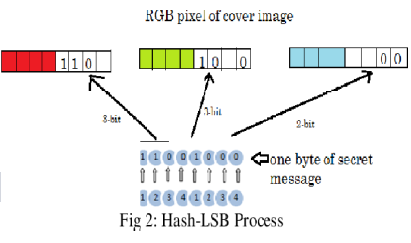
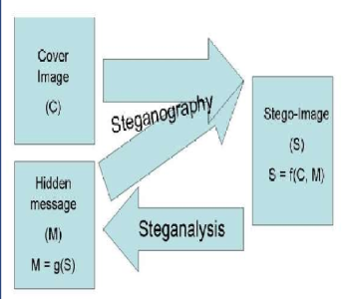
WORKING :
BLOCK DIAGRAM :

Slide 7

THANK YOU VERY MUCH!

